Slide 1
Data Scientist Assessment Task – Shobhan _Mitra Finding the SA2s of Similar Age Structure
.
Presented To:
Dept of Planning, Industry& Environment.
NSW Government.
Presented By :
Shobhan Mitra

Slide 2
Finding the SA2s of Similar Age Structure
To find the SA2s of similar
age Structure.
Five Steps To Follow:
Objective.
Data ingestion (Getting The Data).
Data Exploration and Transformation (Fitting The Data).
Data Confession.
5. Getting the Result.

Slide 3
Finding the SA2s of Similar Age Structure-1.Objective
1.Objective with background:
The Department has a responsibility for determine the future population of NSW and its localities through population projections. As part of this process it is important to understand how age structures vary across different locations in the State.
Part of the preparation for population projections is determining which localities in NSW have
similar age structures.
To find this similar age structure among NSW SA2s, I will apply two different clustering algorithms.

Slide 4
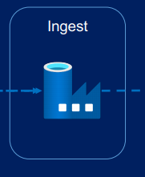

Finding the SA2s of Similar Age Structure-2. Getting the Data
2.Getting the Data:
ABS Estimated Resident Population for 30 June 2019, for ABS Statistical Area 2 (SA2) spatial units.
Data Source:
https://data.gov.au/dataset/ds-aurin-aurin%3Adatasource-AU_Govt_ABS-UoM_AURIN_DB_3_abs_regional_population_summary_sa2_2019/details?q=ABS%20Statistical%20Area%202%20(SA2)%20spatial%20%20units

Slide 5
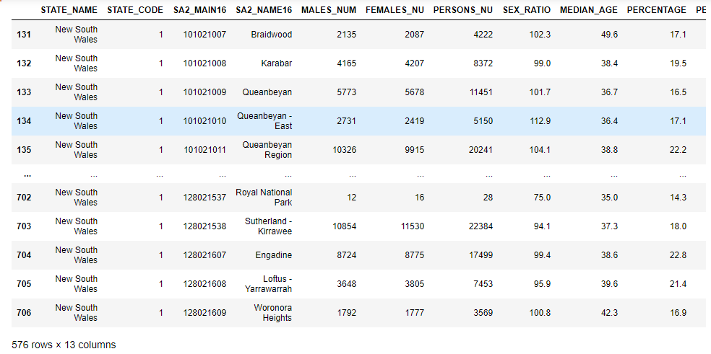
Finding the SA2s of Similar Age Structure-3. Data Exploration & Transformation
3. Data Exploration & Transformation:
The imported data has 2292 rows with all states.
Filtered only NSW states and this data has
576 NSW entries & 13 Attributes. The Attributes are:
1.STATE_NAME;
2.STATE_CODE;
3.SA2_MAIN16;
4.SA2_NAME16;
5.MALES_NUM;
6.FEMALES_NU;
7.PERSONS_NU;
8.SEX_RATIO;
9.MEDIAN_AGE;
10.PERCENTAGE;
11.PERCENTAG0;
12.PERCENTAG1;
13.CPU

Slide 6
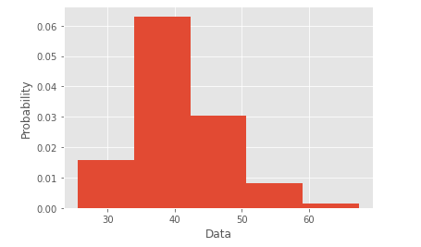
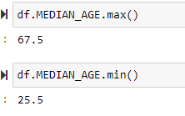
Finding the SA2s of Similar Age Structure-3. Data Exploration & Transformation
3. Data Exploration & Transformation:
To build a two dimensional clustering model, I have considered MEDIAN_AGE and PERCENTAGE attributes.(They together will give a rational correlation regards age similar clusters.)
I got rid of some Null values in the data and finally get the data as follow ready to be clustered.
Explored the Min and Max of MEDIAN_AGE along with Bin creation.

Slide 7
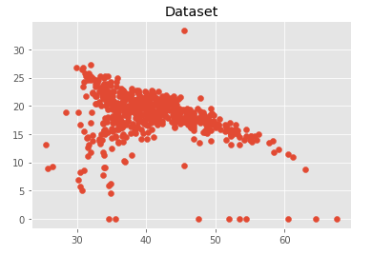
Finding the SA2s of Similar Age Structure-3. Data Exploration & Transformation
3. Data Exploration & Transformation:
Finally, I Plotted the Dataset as follows which is ready to be clustered

Slide 8
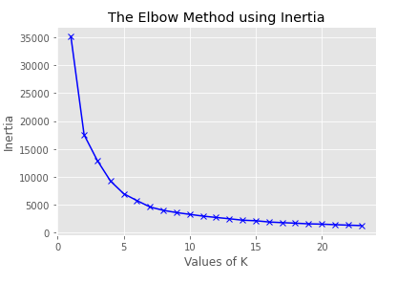
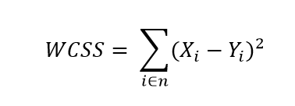
Finding the SA2s of Similar Age Structure-4. Data Confession with K-Means Clustering Algorithm
4. Finding The optimum K value:
Elbow method is one of the robust one used to find out the optimal number of clusters.
Within-Cluster-Sum-of-Squares (WCSS) is computed as
Yi is centroid for observation Xi.
Here, the elbow point is 5, so the considered cluster will be k=5.

Slide 9
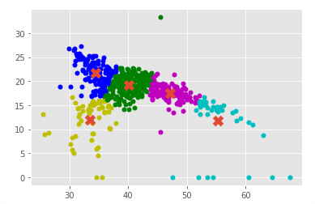
Finding the SA2s of Similar Age Structure-4. Data Confession with K-Means Clustering Algorithm
Here we are seeing 5 clusters.
Not covering all nodes very well.

Slide 10
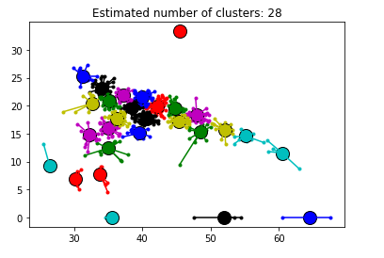
Finding the SA2s of Similar Age Structure-4.Data Confession with Affinity Propagation Clustering Algorithm
Affinity Propagation Clustering Algorithm:
The main drawbacks of K-Means and similar algorithms are having to select the number of clusters, and choosing the initial set of points.
Affinity Propagation does not need to select clusters before running. Instead,it takes a set of pairwise similarities between data points, and finds clusters on by maximizing the total similarity between Data Points.

Slide 11
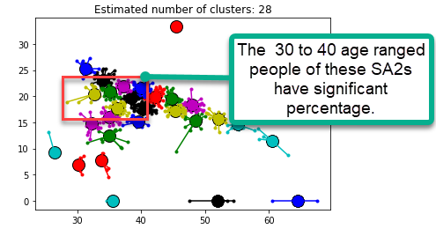
Finding the SA2s of Similar Age Structure-5.Insights/Result
Some Special Insights and Findings Of The Model:

Slide 12
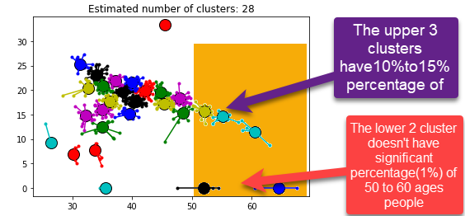
Finding the SA2s of Similar Age Structure-5.Insights/Result
Some Special Insights and Findings Of The Model:

Slide 13
Thank you
=74.62%
268
Thank you very much !
=77%
30
=73%
38
95
=74.94%

